Slide 1


University Clubs Website
Team 6
Hilal Türkyılmaz
Beyza şahin
Esmanur aytaş
Advisor: Muhsin Zahid UĞUR

Slide 2

Problem
Low Participation in University Clubs
Many students are unaware of upcoming events and opportunities.
Lack of centralized information for events leads to low engagement.

Slide 3
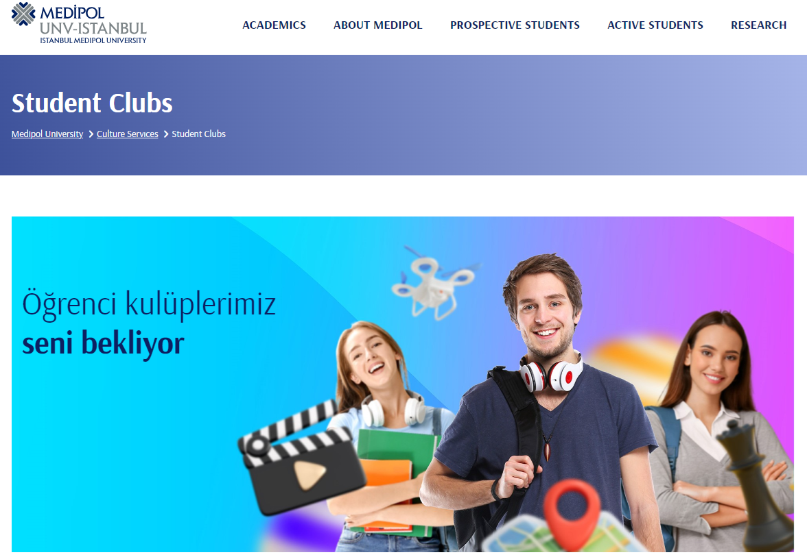
Solution
University Clubs Website
A platform for students to discover and book events easily.
Why is your solution better?
Reason 1: Centralizes all university club events in one accessible location.
Reason 2: Simplifies the booking process, making it user-friendly.
Reason 3: Facilitates social interactions among students, enhancing campus life.

Slide 4
aims
Aim 1: Increase student participation in university clubs by providing a comprehensive event listing.
Aim 2: Streamline the event booking process for students, minimizing barriers to participation.
Aim 3: Foster a stronger campus community by encouraging social engagement through events.

Slide 5
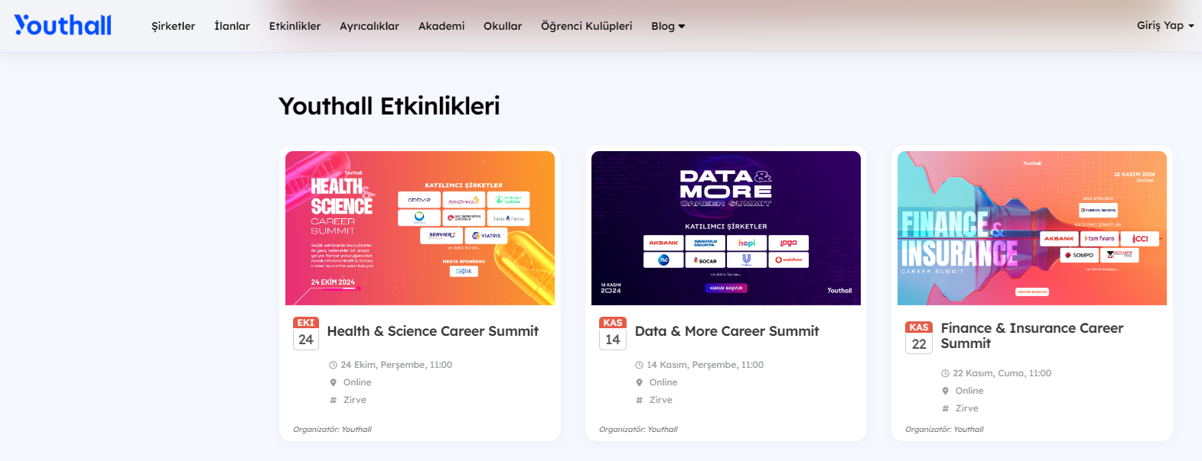
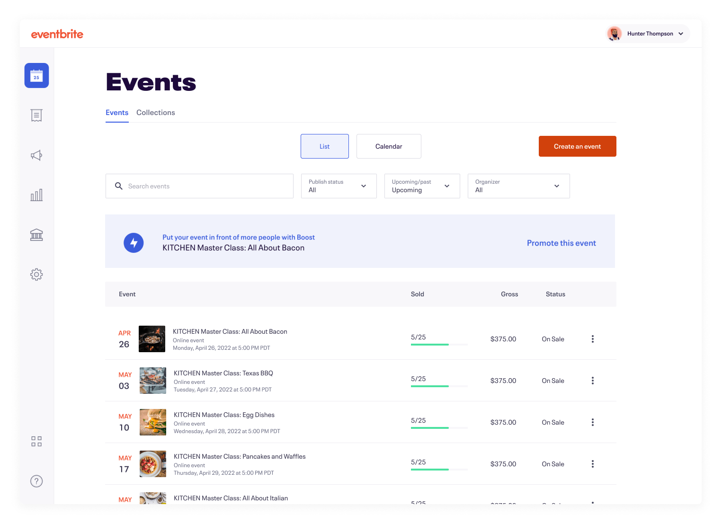
Similar products on the market
Product 1: Youthall
A platform for youth events.
Why is it good?
Offers various events but lacks focus on university-specific activities.
Missing Features: Limited information on university club events and participation analytics.
Product 2: Eventbrite
A popular event management tool for general events.
Why is it good?
Robust event management features and widespread use.
Missing Features: Not tailored for university environments; students may find it.

Slide 6
functionality
Main Functionality:
Inform students about upcoming events and simplify the booking process. (event listing, ticket purchasing)
Details: Centralized event information fosters community engagement.
Other Functionalities:
Event detail pages with date, time, location, and description. (event management dashboard)
Details: Allows students to make informed decisions about participation.

Slide 7
USERS and environment
Users:
Students: Search events, book tickets.
Club Members/Leaders: Manage profiles, create events, track bookings, interact with attendees, analyze data.
Administrative Staff: Oversee events, ensure policy compliance, access reports, approve or monitor club events.
External Sponsors: View event stats, post ads.
Environment:
Main environment: University campus (libraries, study halls, cafeterias, common areas).
Technology: Wi-Fi available, but signal strength may vary by location.

Slide 8





technology
Frontend (HTML, CSS, JavaScript):
Creates the user interface for easy navigation.
Database (MySQL):
Manages event and reservation data efficiently.
Backend (Python):
Processes reservations and manages user accounts.

Slide 9
Challenges foreseen
User-Friendly Interface: Catering to various user roles while maintaining simplicity.
Integration Issues: Smooth data flow between front-end and back-end systems.
Event Overlap Management: Avoiding double bookings through an effective scheduling system.

Slide 10
Division of labor
Esmanur AYTAŞ
Team Leader, Backend Developer
Beyza ŞAHİN
DBA, UI Designer
Hilal TÜRKYILMAZ
Frontend Developer, Tester

